Slide 1
SKILLFORGE AI DRIVEN ADAPTIVE LEARNING AND EXAM GENERATOR

Slide 2

INTRODUCTION
SkillForge focuses on personalized learning, adaptive assessments, and continuous skill improvement using AI.
SkillForge can be used in education institutes, corporate training, placement preparation, and online learning platforms to provide personalized and adaptive learning

Slide 3
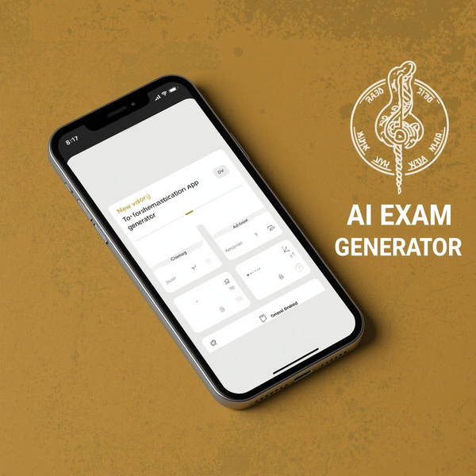
PROBLEM STATEMENT
In today’s education system, most online learning platforms provide the same content and exams to all students. They do not consider individual learning speed, strengths, or weaknesses. Because of this, some students struggle to understand concepts, while others feel the content is too easy.
There is a lack of personalized learning and smart exam generation systems that can adapt to each student’s performance.
SkillForge is designed to solve this problem. It uses Artificial Intelligence to analyze student performance, identify weak areas, adjust difficulty levels, and generate personalized exams. The system also provides performance reports and recommendations to help students improve continuously.
The main objective of this project is to create an intelligent, adaptive learning system that improves student understanding, confidence, and exam performance.

Slide 4
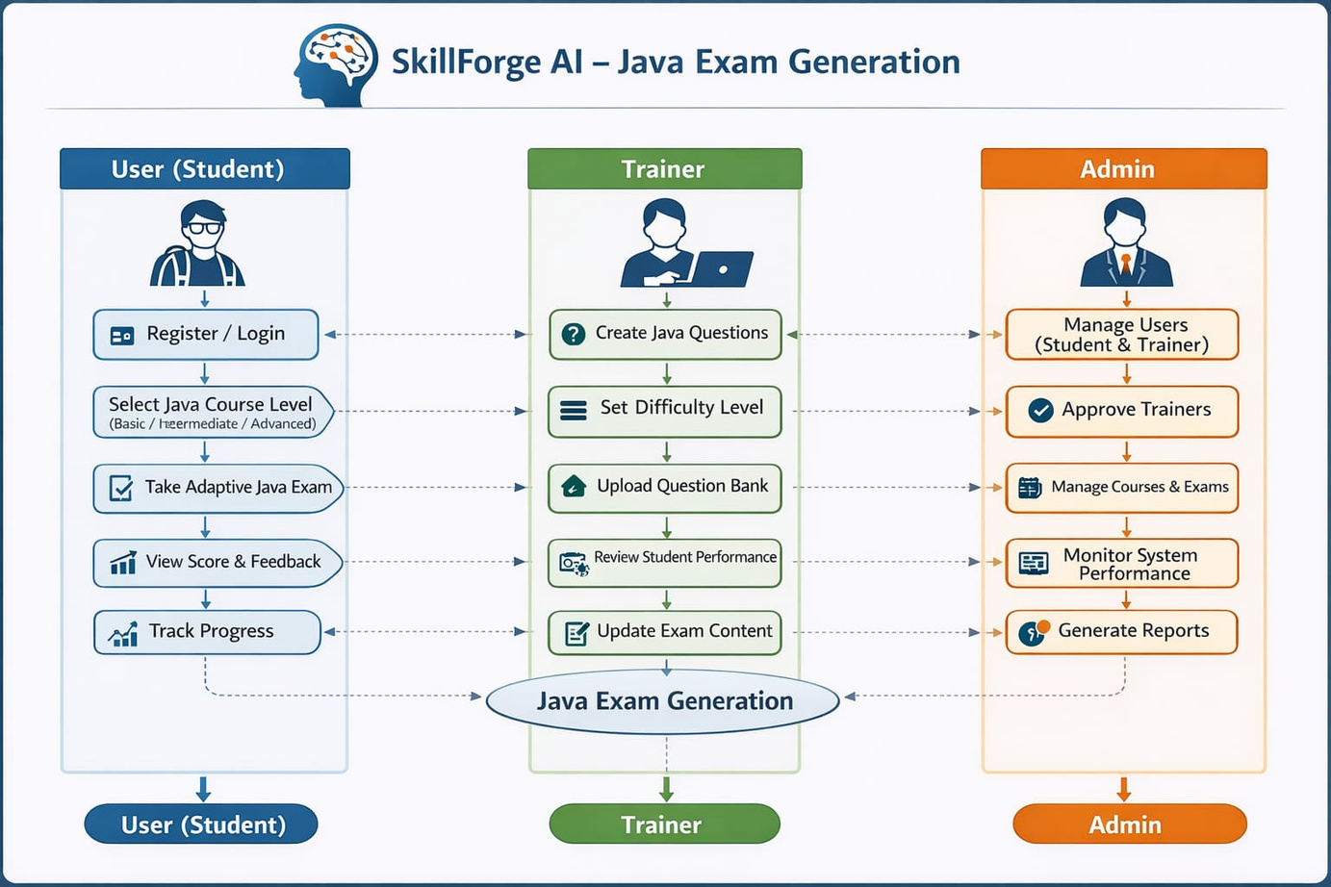
USE CASE DIAGRAM

Slide 5
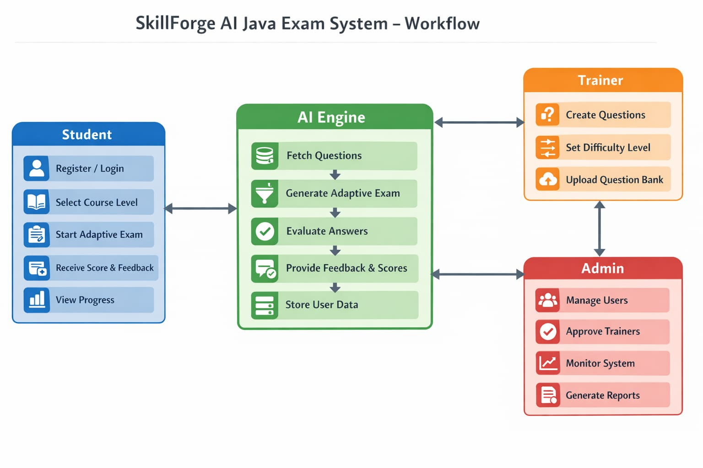
WORKFLOW DIAGRAM

Slide 6
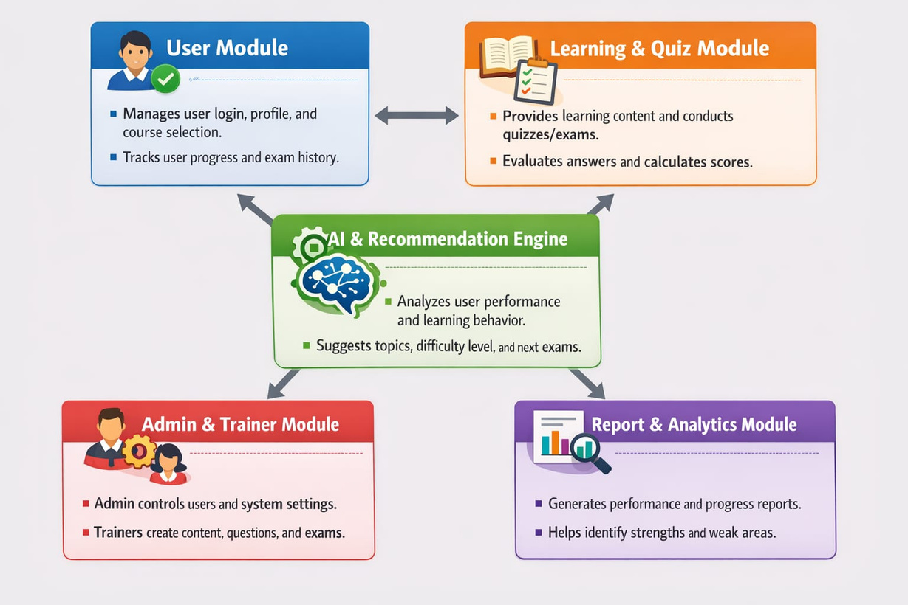
MODULES

Slide 7
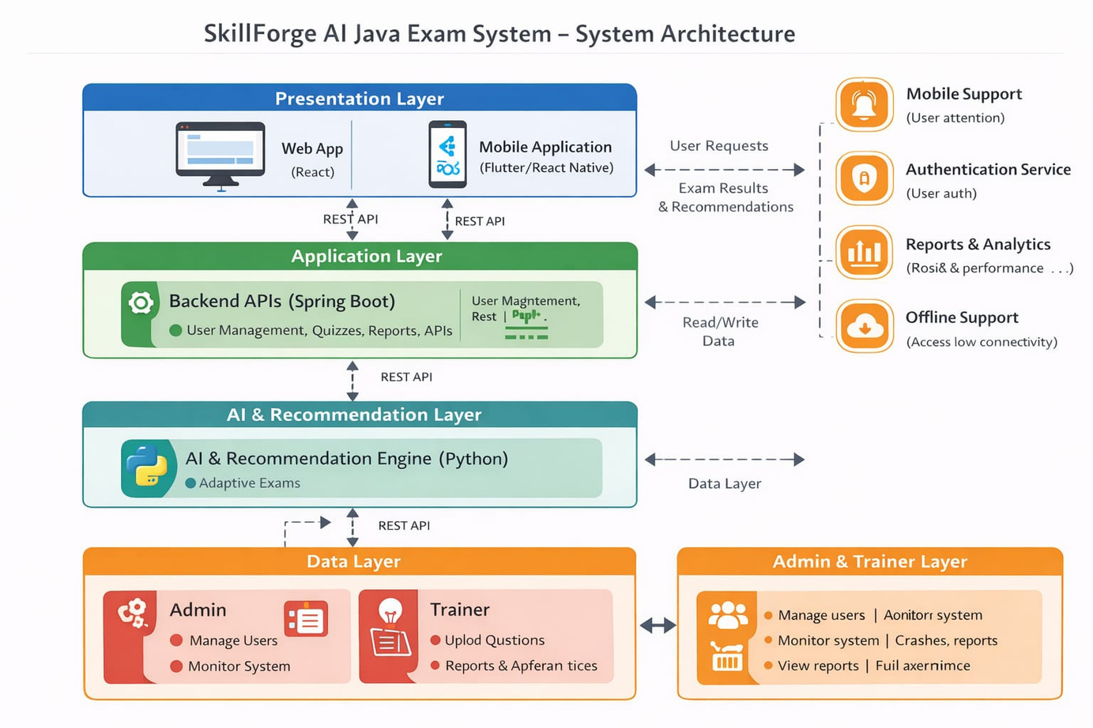
SYSTEM ARCHITECTURE

Slide 8
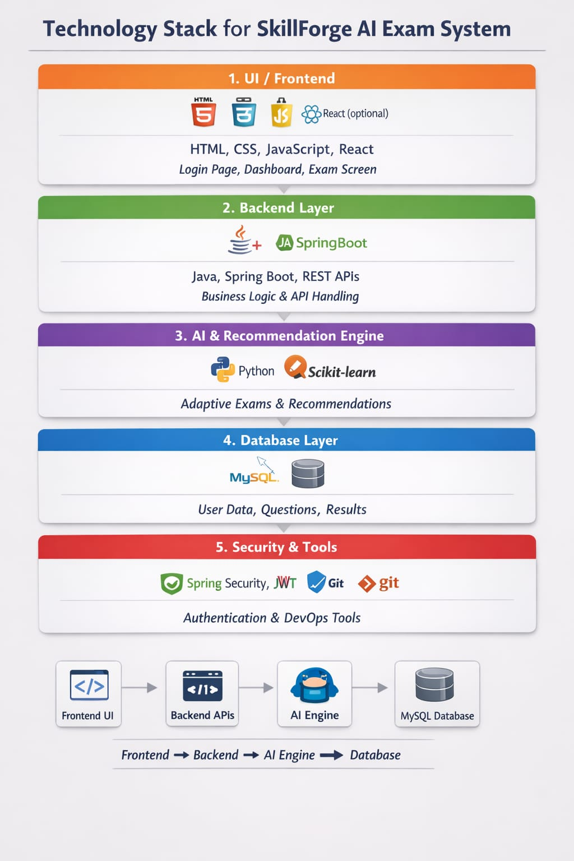
TECH STACK

Slide 9
THANK YOU

